Slide 1
Durban Market Analysis
Analytics Alchemy
Onalenna Magoro
Pfumelani Shibonze
Mongezi Chibi
Mohamed Rasool
Percival Shimange

Slide 2
Introduction
Durban market dataset
From the 2019-12-11 to 2020-10-03
Contains commodities and its corresponding information from different areas of South Africa as well as foreign imports
Data cleaning
EDA
Dropped 8 rows containing missing values
Feature engineering (adding selling price and date columns)

Slide 3
Analysis

Slide 4
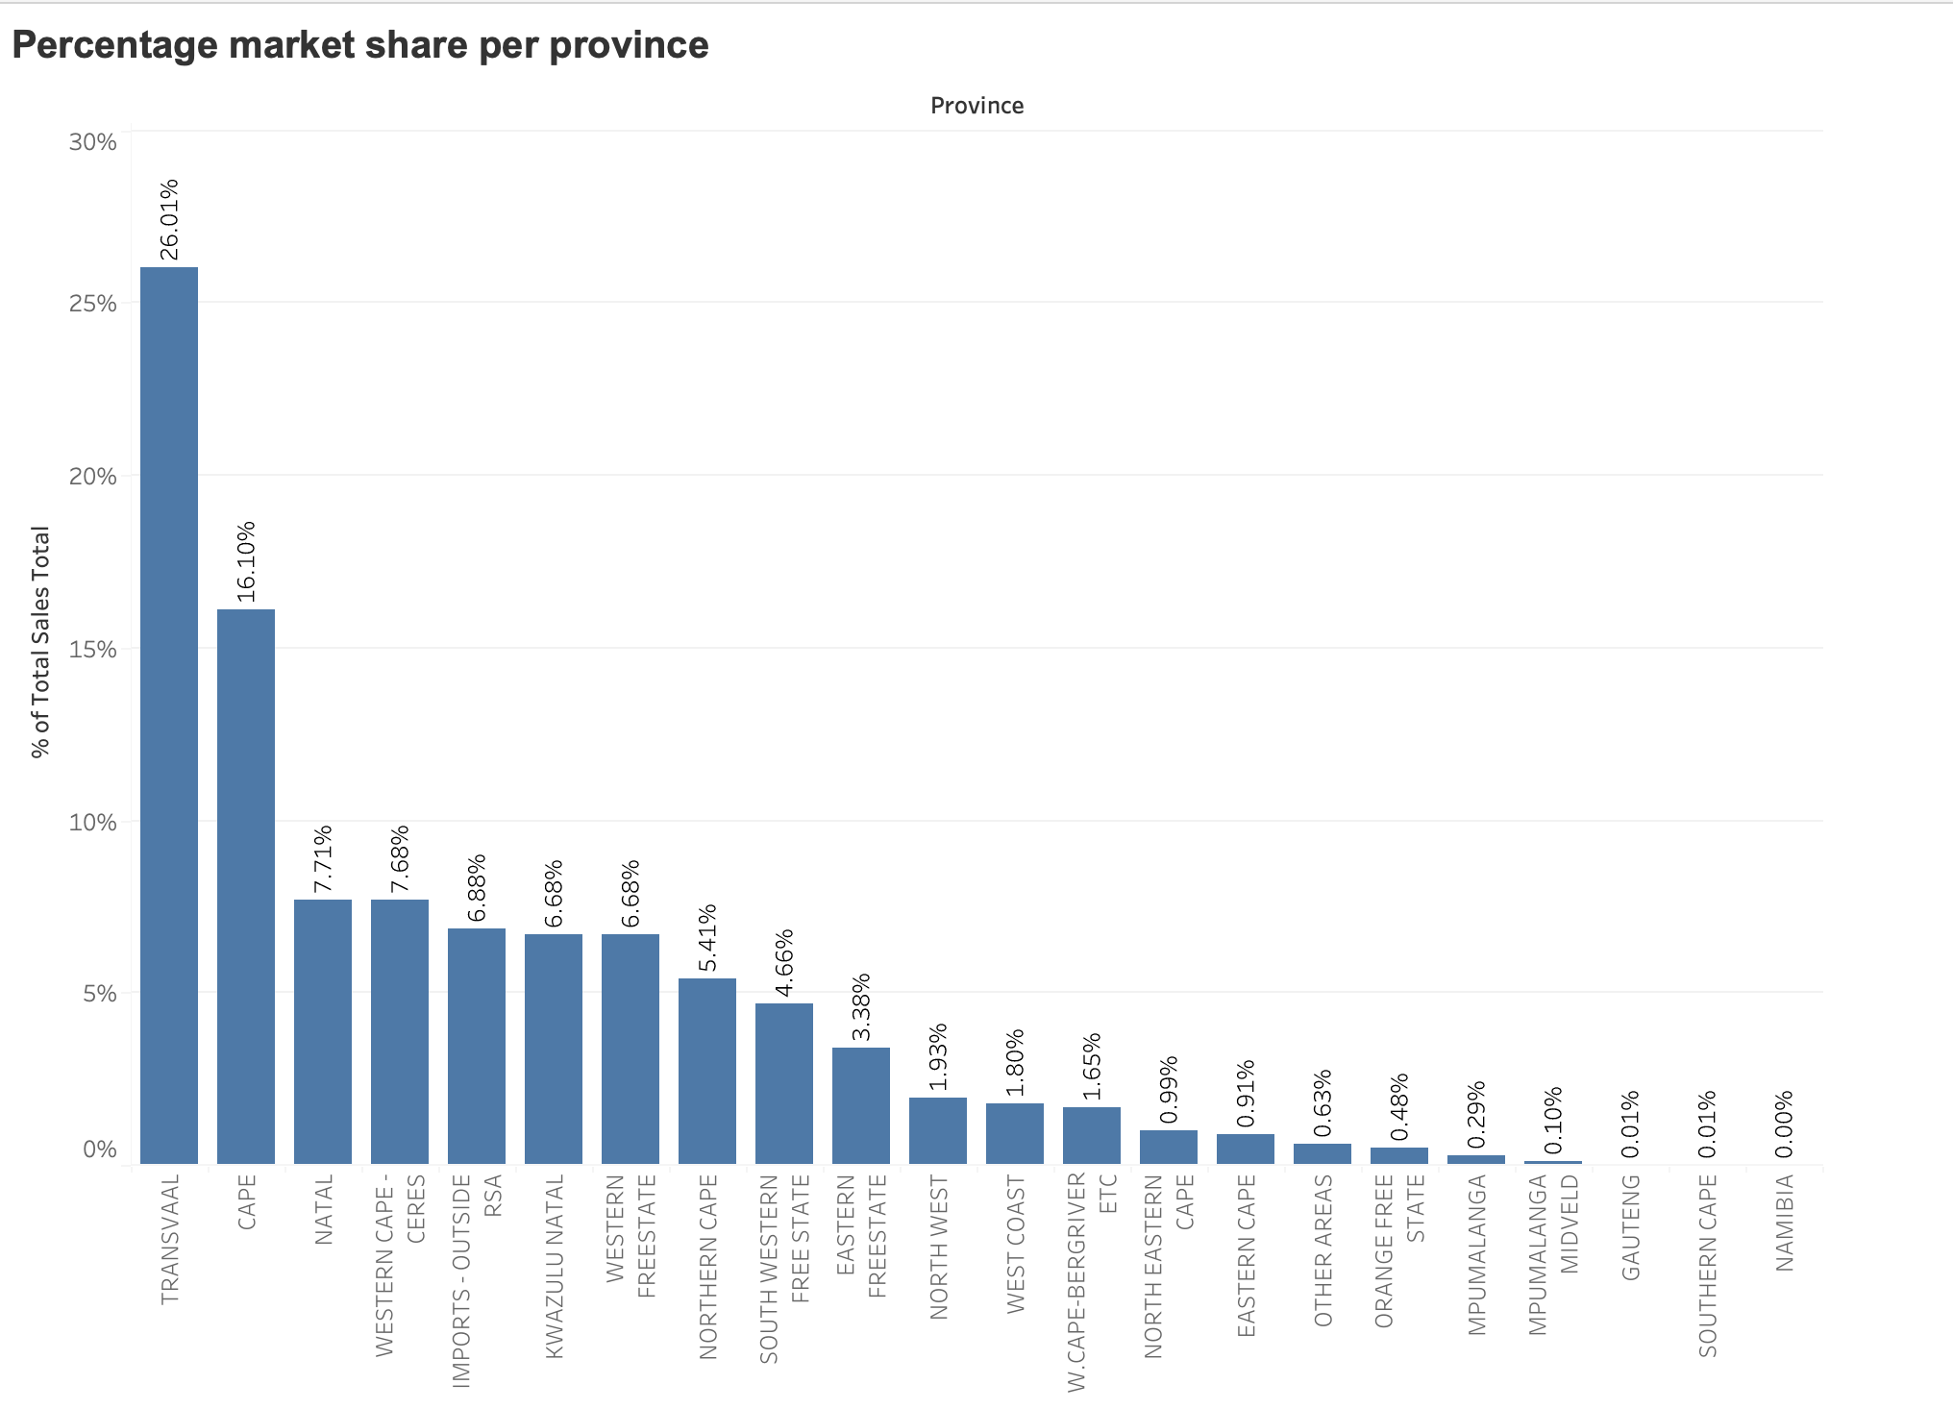

Slide 5
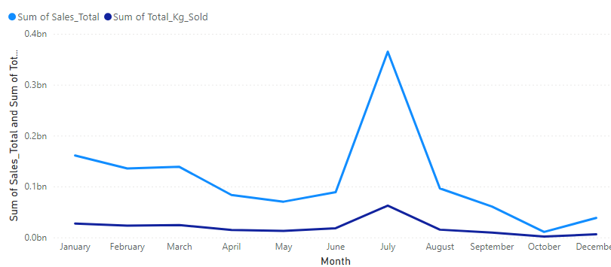
Sum of Sales And Sum of Total_Kg_Sold By Month

Slide 6
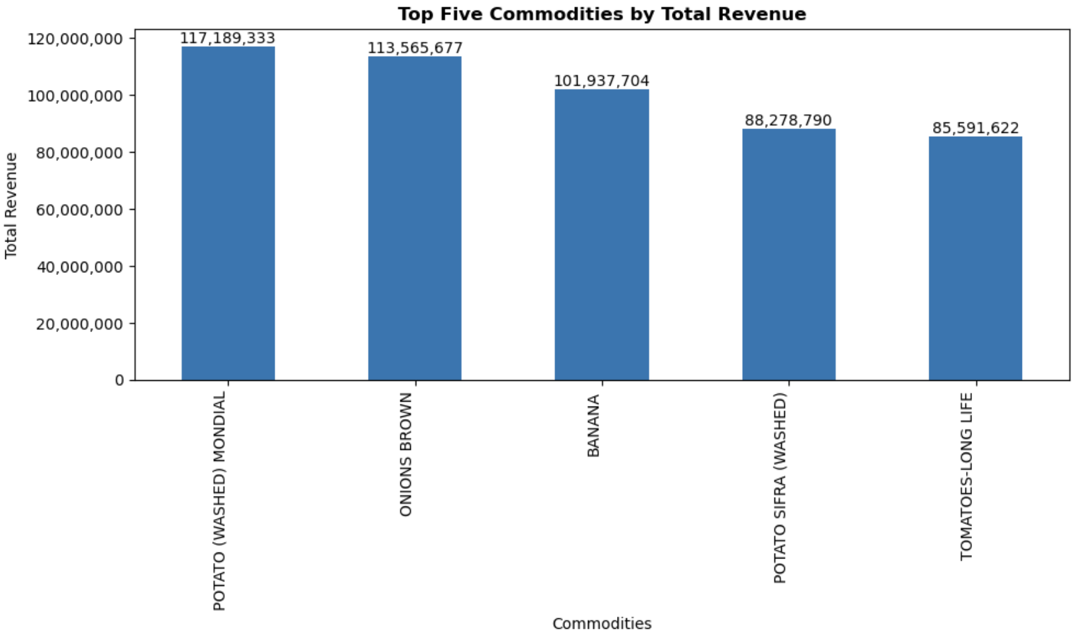

Slide 7
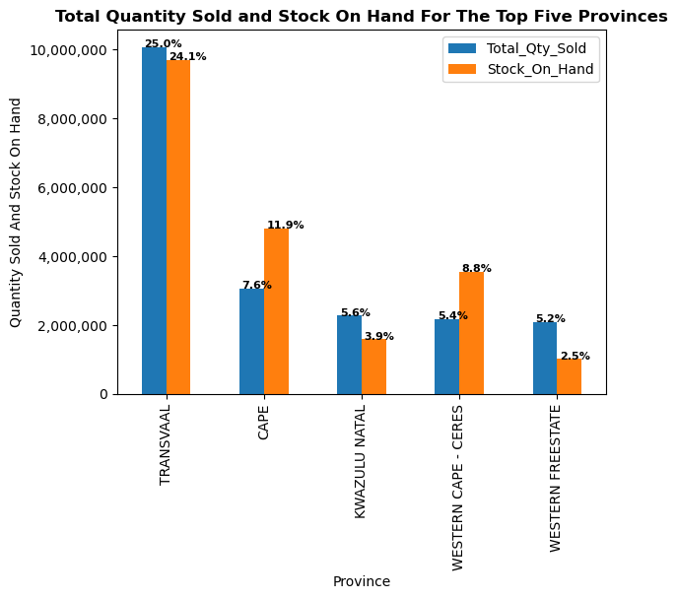

Slide 8
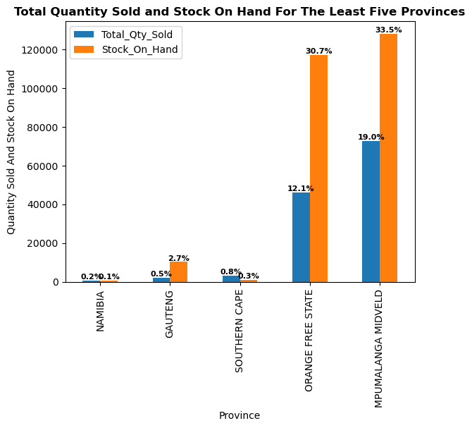

Slide 9
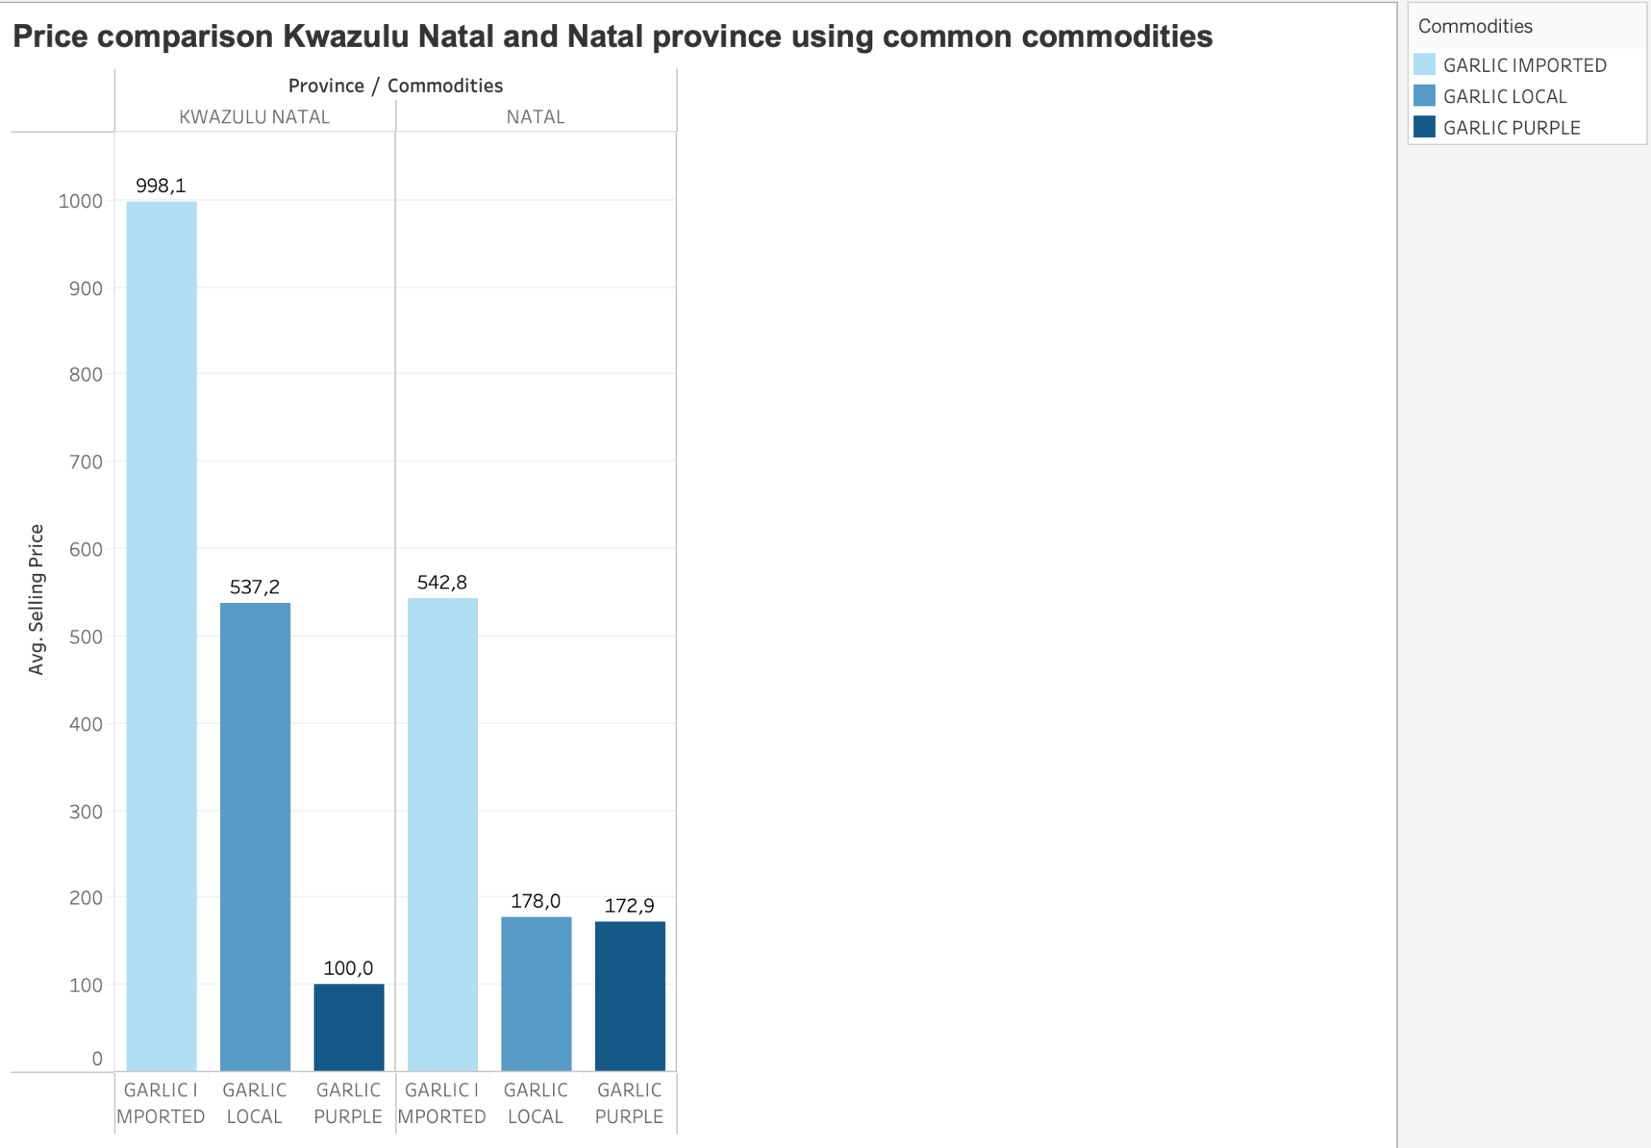

Slide 10
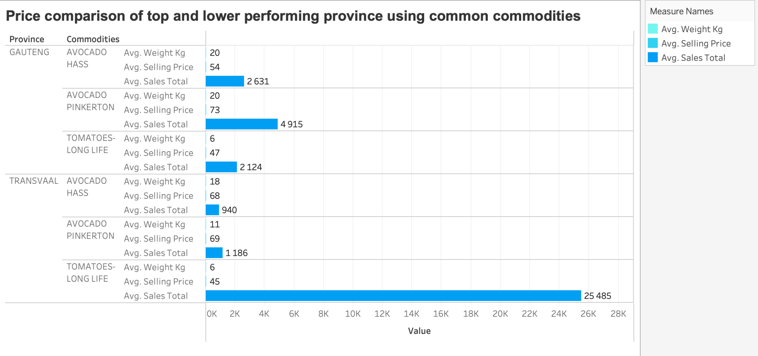

Slide 11
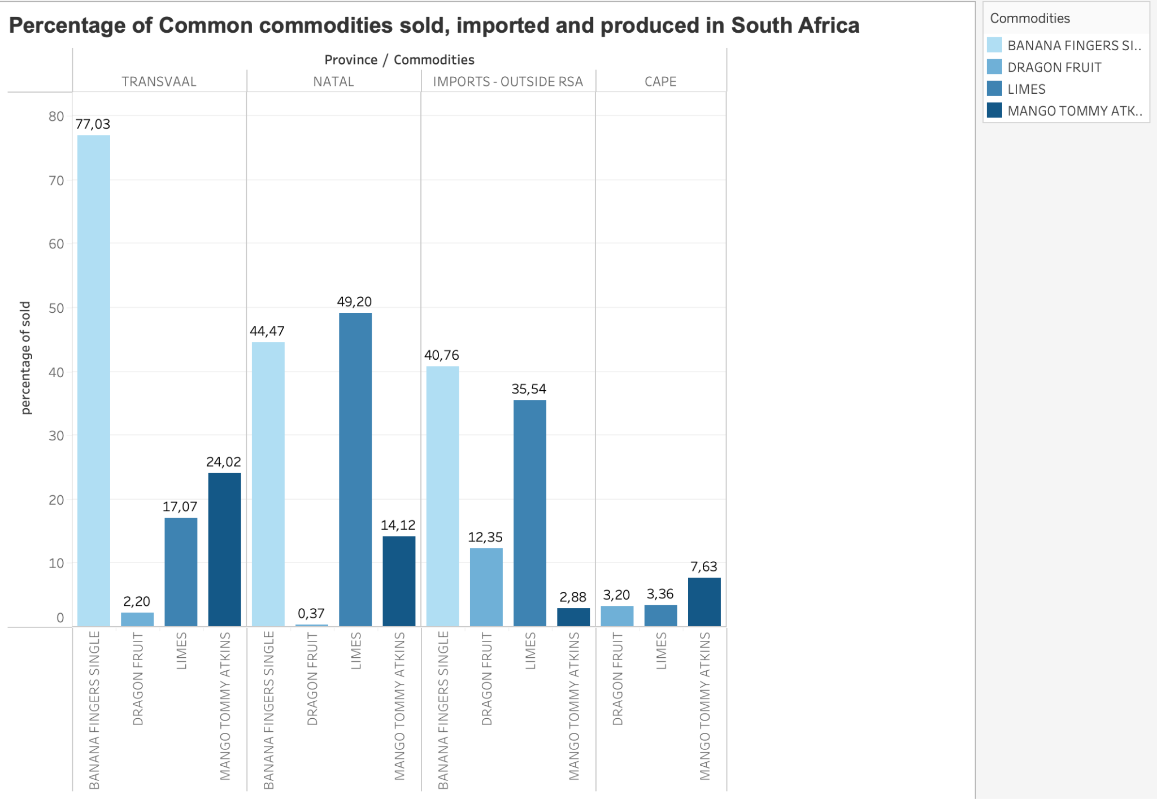

Slide 12
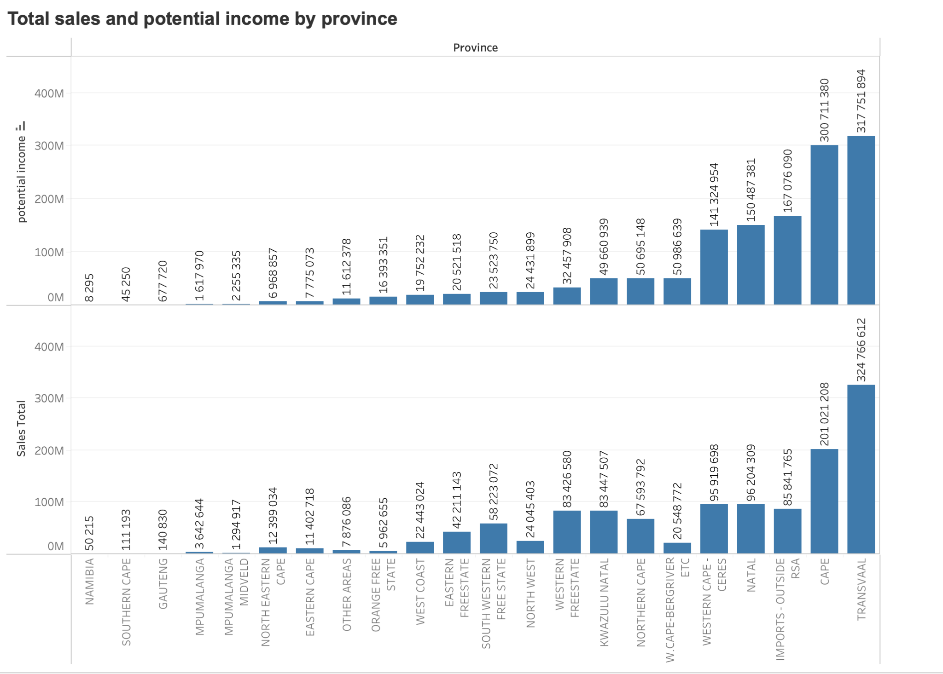

Slide 13
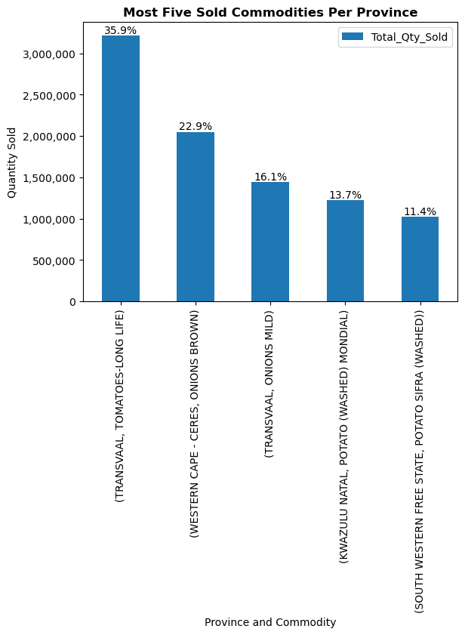

Slide 14
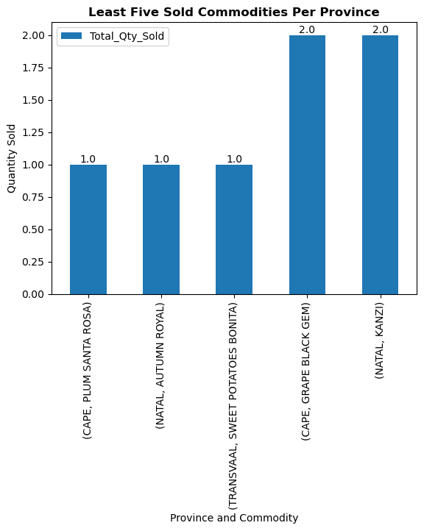

Slide 15
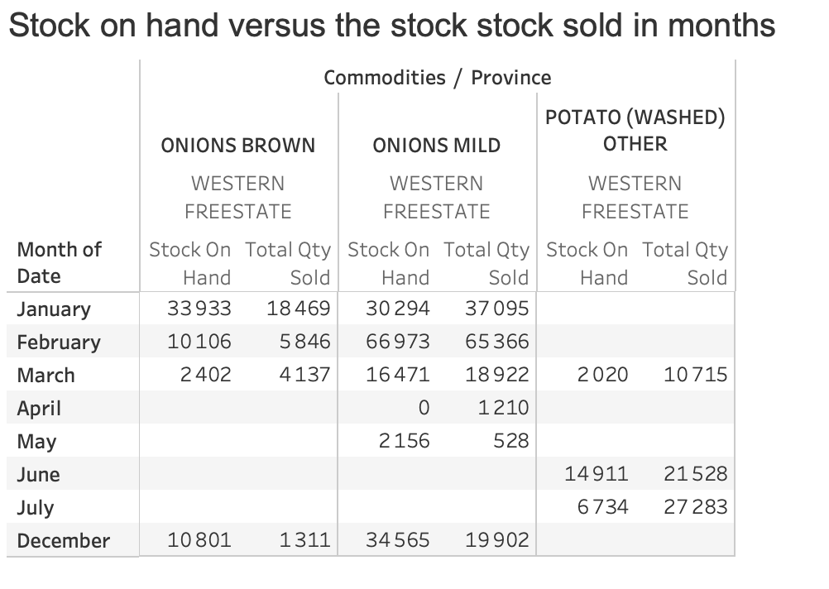

Slide 16
